Slide 1

Remote Uncrewed Aircraft System (UAS) Inspection and Response Team Development in the Bering Strait Region
Dr. Jessica Garron, Principal Investigator
International Arctic Research Center, University of Alaska

Slide 2
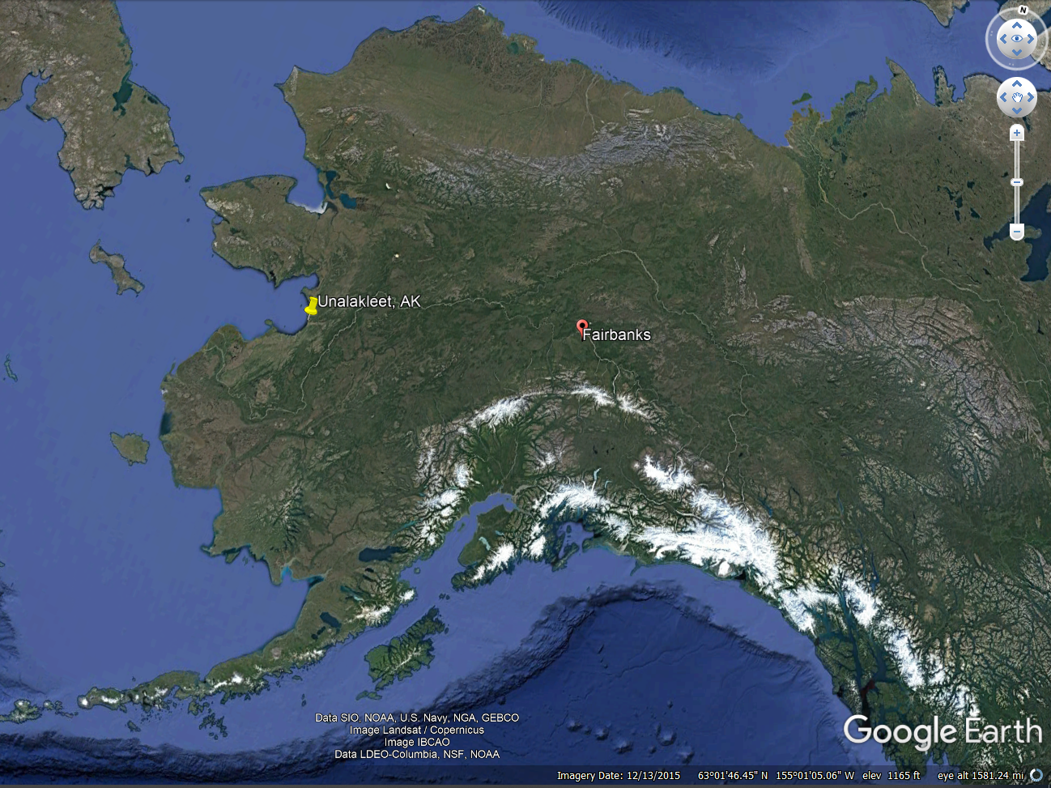
Land Acknowledgement
ADAC Program Year 8 Annual Meeting 20-21 April 2022
My home and office are located on the traditional land of the Lower Tanana Dene people in an area that is now known as Fairbanks, Alaska. This project will take place on the traditional lands of the Inupiat and Yupik people in an area that is known today as Unalakleet, Alaska.

Slide 3

Remote Unmanned Aircraft System (UAS) Inspection and Response Team Development in the Bering Strait Region
ADAC Program Year 8 Annual Meeting 20-21 April 2022
Principal Investigators
  Dr. Jessica Garron, Research Faculty, International Arctic Research Center, University of Alaska Fairbanks
  John Henry Jr, Deputy Director, Native Village of Unalakleet
  Margy Hall, Associate Director, Model Forest Policy Program
  CDR Jereme Altendorf, USCG Sector Anchorage
Project Champions
  CDR Chad Thompson, USCG HQ
  LCDR John Walters, USCG HQ
Hall and Garron performing site survey at delta of Unalakleet River flowing into Bering Sea. Photo c/o M. DeLue

Slide 4
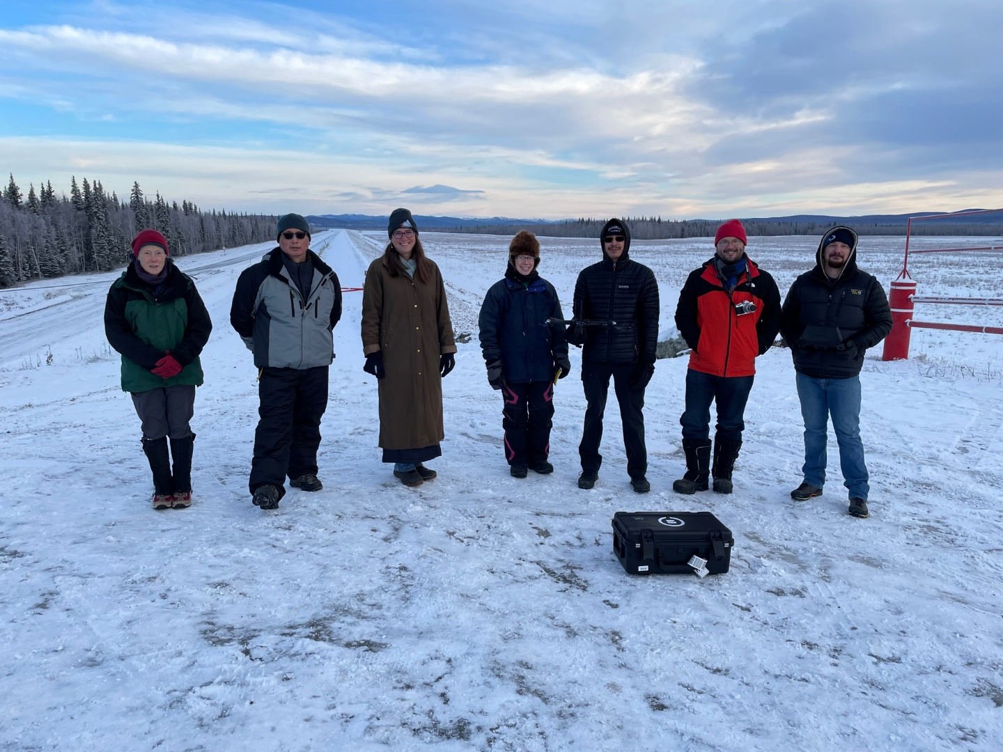
Remote Uncrewed Aircraft System (UAS) Inspection and Response Team Development in the Bering Strait Region
ADAC Program Year 8 Annual Meeting 20-21 April 2022
NVU UAS Pilots
Katie Daniels
Harry Ivanoff
UAF UAS Pilots
Mike DeLue
Sam Jefries
L to R: Margy Hall (Co-I), John Henry, Jr. (Co-I), Jessica Garron (PI), Katie Daniels (NVU UAS), Harry Ivanoff (NVU UAS), Mike DeLue (UAF UAS), Sam Jeffries (UAF UAS)

Slide 5
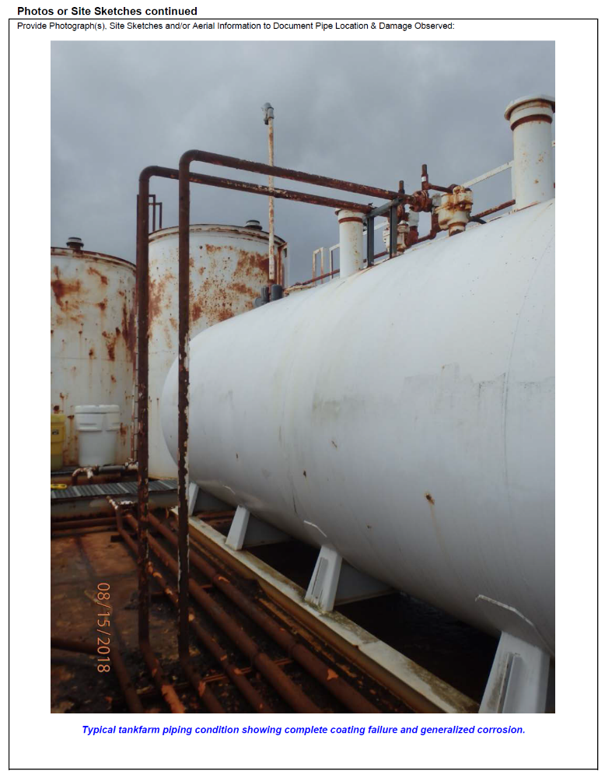
Baseline Conditions and Project Relevance
USCG Mission Needs
ADAC Program Year 8 Annual Meeting 20-21 April 2022
Diminished sea ice coverage in Northern oceans allows for more vessel traffic in the Bering Sea.
USCG responders have identified the need for more effective strategies to prevent and address marine disaster response in Western Alaska, and specifically the Bering Strait region.
A critical need exists to improve inspections and inspection frequency of rural bulk fuel facilities across remote regions in the Arctic and Western Alaska.
USCG D17 Sector Anchorage identified staffing challenges, extraordinary logistics and associated costs of travel to remote/off road system rural Alaska,
  363 regulated facilities not on road system requiring inspection; 6 billeted facility inspectors.
Sample bulk fuel storage tank in remote Alaska. Image c/o the Denali Commission

Slide 6
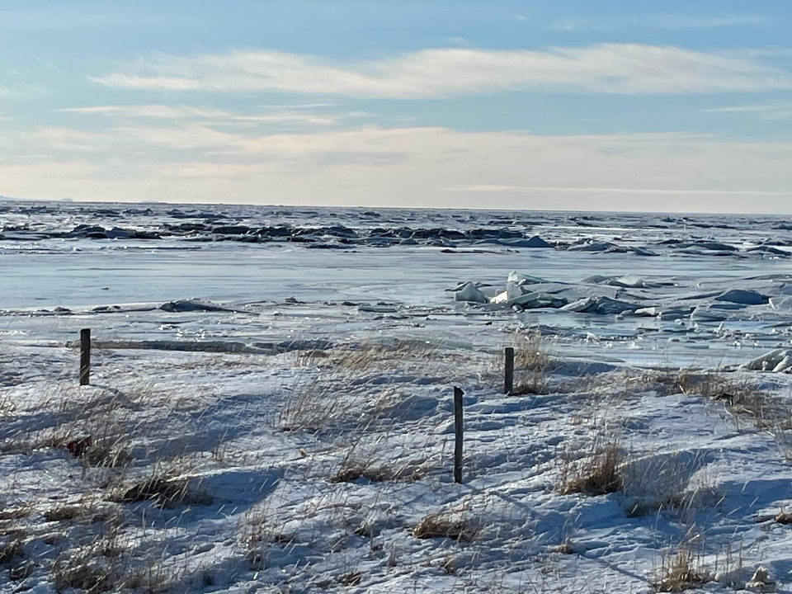
Baseline Conditions and Project Relevance
Unalakleet Community Needs
ADAC Program Year 8 Annual Meeting 20-21 April 2022
Impacts of diminished sea ice coverage in Northern oceans,
More vessel traffic in the Bering Sea
Reduced offshore ice protection
Increased frequency of fall storms
Increased current flow and direction
Changing river conditions are causing,
Early breakup
More turbidity
Increased erosion
Need localized solution for broad situational awareness during emergencies
Search and rescue activities
Oil spill detection and monitoring
Climate change monitoring
A precursor study competed in 2020 by Henry, Garron & Hall, Improving Local Decision Making in Alaskan Communities with Drones and Online Climate Data Tools - A UAS Implementation Feasibility Study Project, identified UAS as a viable tool in support of local decision-making in remote Alaska.
Bering Sea from Unalakleet. Photo c/o J. Garron

Slide 7
Project Rationale and Description
ADAC Program Year 8 Annual Meeting 20-21 April 2022
UAS potentially provide a localized, inexpensive, remote sensing solution, ideal for hazardous and hard to access tasks in remote Alaska.
This project is designed to develop UAS pilot teams in the Bering Strait region in support of decision-making about infrastructure status and emergency response activities. This work includes the remote training and certification of 7 members of the Unalakleet community to be UAS pilots, the coproduction of bulk fuel infrastructure assessment and emergency response UAS protocols, inclusive of remote data delivery investigations, the feasibility of expanding this training program regionally, and the broad dissemination of knowledge gained to other remote Arctic communities interested in applying UAS technology to local decision-making.

Slide 8
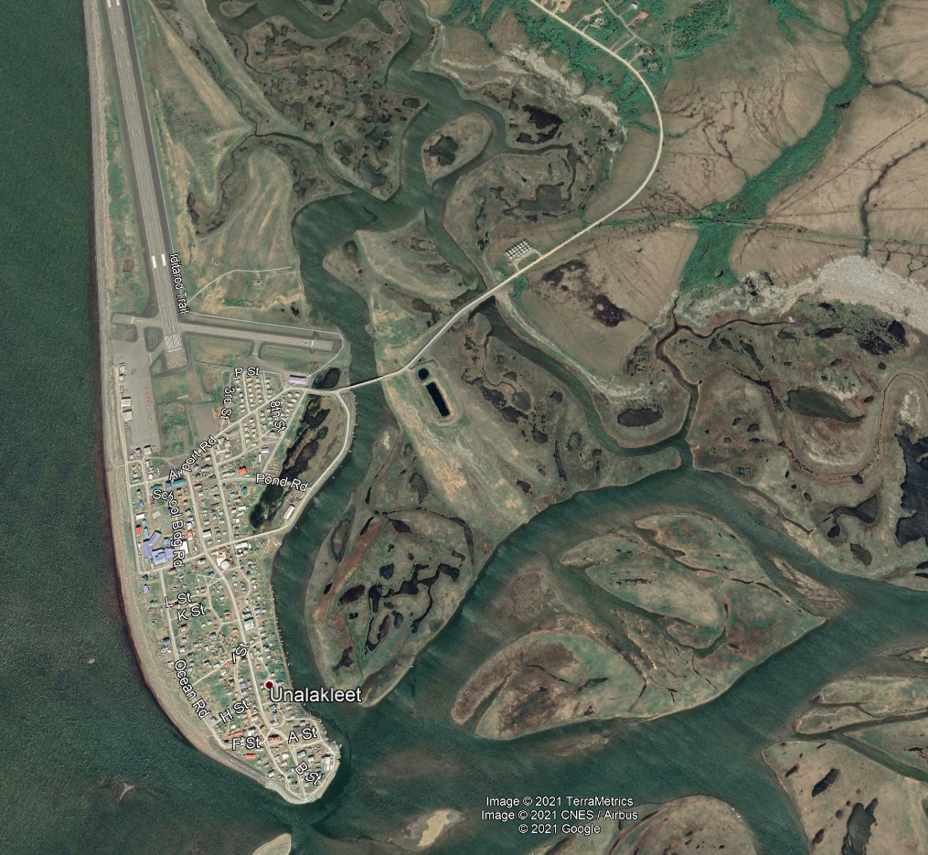
Remote Uncrewed Aircraft System (UAS) Inspection and Response Team Development in the Bering Strait Region: Methodology
ADAC Program Year 8 Annual Meeting 20-21 April 2022
Scenario-based research design
Community needs
USCG mission
UAS applications

Slide 9
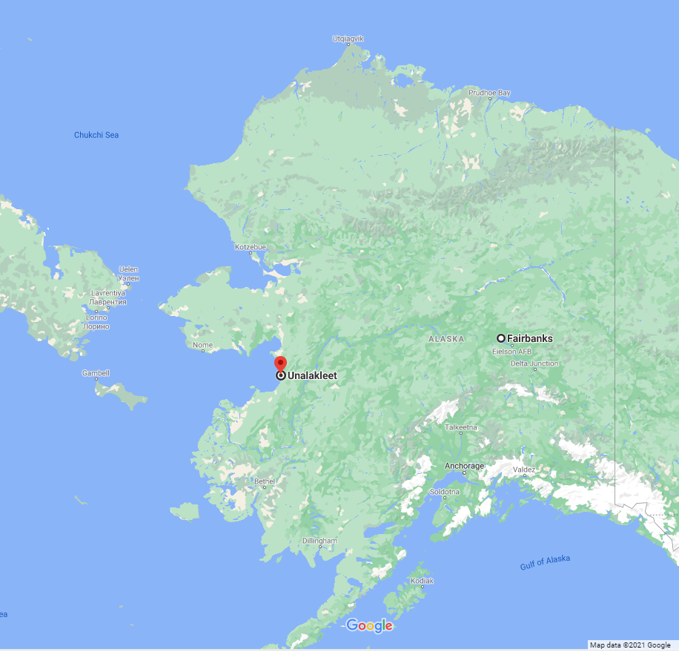
Methodology
ADAC Program Year 8 Annual Meeting 20-21 April 2022
Sequenced methodology is oriented to,
Provide UAS pilot training of rural residents,
Establish co-production of infrastructure assessment operational UAS protocols,
Establish co-production of emergency assessment UAS protocols,
Conduct information dissemination,
Provide regional expansion feasibility analysis.

Slide 10
Remote Uncrewed Aircraft System (UAS) Inspection and Response Team Development in the Bering Strait Region: Schedule and Metrics
ADAC Program Year 8 Annual Meeting 20-21 April 2022
Task 1: UAS Pilot Training and Certification
Task 2: Coproduction of Infrastructure Inspection Operational Protocols
Task 3: Coproduction of Emergency Response Assessment Protocols
Task 4: Regional Expansion Feasibility Assessment
Task 5: Information Dissemination
June 2021
April 2022

Slide 11
Primary Tasks and Objectives
July 1, 2021 - March 31, 2022
ADAC Program Year 8 Annual Meeting 20-21 April 2022
Task 0 – Project Coordination
Program establishment,
Conduct team coordination meetings – internal/external (on-going),
Reporting (on-going).
Task 1 – UAS Pilot Training and Certification
Recruit UAS pilot teams,
Deliver remote UAS pilot training,
Acquire operational UAVs, sensors and software,
Support FAA certification of UAS pilots,
Deliver on-site UAS flight training.
Task 2 - Coproduction of Infrastructure Inspection Operational Protocols
Determine current tank and fuel delivery infrastructure inspection requirements,
Coproduce a UAS-based tank and fuel delivery infrastructure inspection protocol,
Perform infrastructure inspection flights and product delivery tests.
Task 3 - Coproduction of Emergency Response Assessment Protocols
Determine key community assets for monitoring pre/post emergency response,
Coproduce emergency response UAS protocol based upon surveys of key community assets,
Perform emergency response baseline flights and product delivery tests.
Task 4 – Regional Expansion Feasibility Assessment
Summarize key (local and regional) documents for critical infrastructure and emergency response information,
Develop regional contact list and conduct regional UAS survey.
Finalize Assessment.
Task 5 - Knowledge Product Development Information Dissemination
Create USCG-focused Knowledge Product (on-going),
Engage non-technical stakeholders (locally, regionally, nationally) (on-going),
Develop and submit publication about sensor capacity testing and general inspection methodology to technical journal.
On-going work
Completed work
Upcoming work

Slide 12
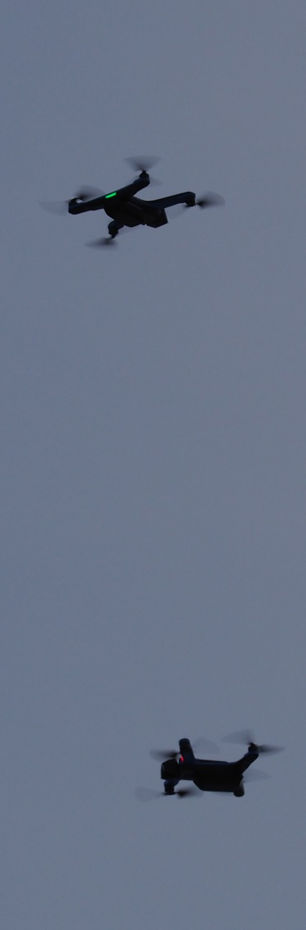
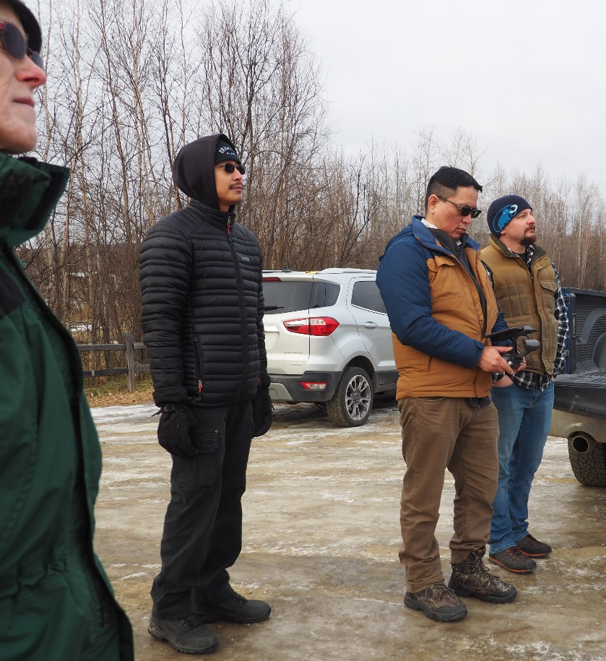
Remote Uncrewed Aircraft System (UAS) Inspection and Response Team Development in the Bering Strait Region: Task 1 – UAS Pilot Training and Certification
ADAC Program Year 8 Annual Meeting 20-21 April 2022
Recruit UAS pilot teams (ADAC Y7),
Deliver remote UAS pilot training (ADAC Y7),
  Mondays from 1300-1500 AKDT via Zoom,
  Recordings via YouTube, FB, and email,
Acquire operational UAVs, sensors and software,
Support FAA certification of UAS pilots,
Deliver on-site UAS flight training.
Above: Hands-on training November 2021;
Right: Dueling drones during equipment testing.

Slide 13
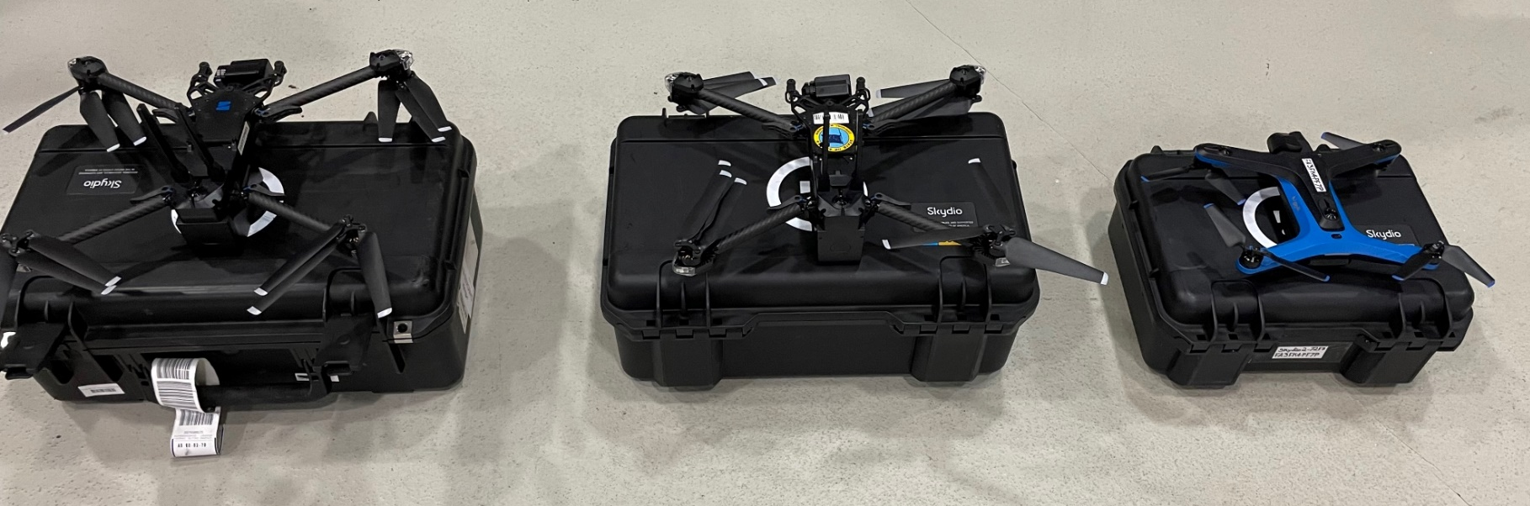
ADAC Program Year 8 Annual Meeting 20-21 April 2022
Remote Uncrewed Aircraft System (UAS) Inspection and Response Team Development in the Bering Strait Region: Task 1 – UAS Pilot Training and Certification
Skydio
Designed, assembled and supported in the USA
  2D scan for linear and area mapping
  3D scan for infrastructure inspections
  360° obstacle avoidance via AI powered autonomy
S2 – Training/operational aircraft with electro-optical sensor
X2E - Operational aircraft with electro-opticl and longwave infrared (thermal) sensors
The Skydio Fleet - X2E with electro-optical and infrared sensors, X2E with electro-optical sensor, S2 with electro-optical sensor. Photo c/o R. Marlowe, AKDOT.

Slide 14
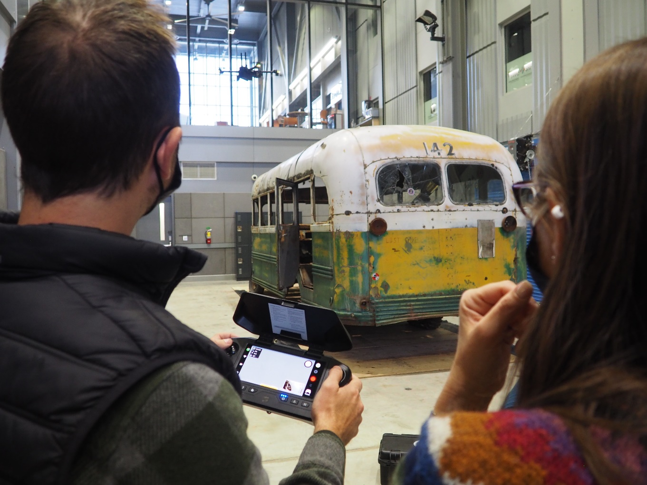
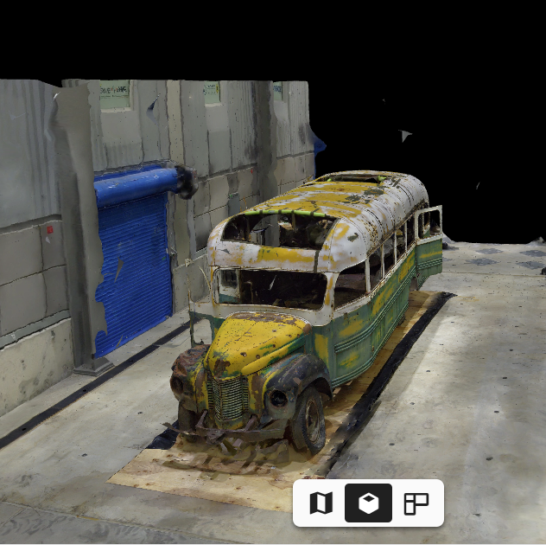
ADAC Program Year 8 Annual Meeting 20-21 April 2022
3D Mapping

Slide 15
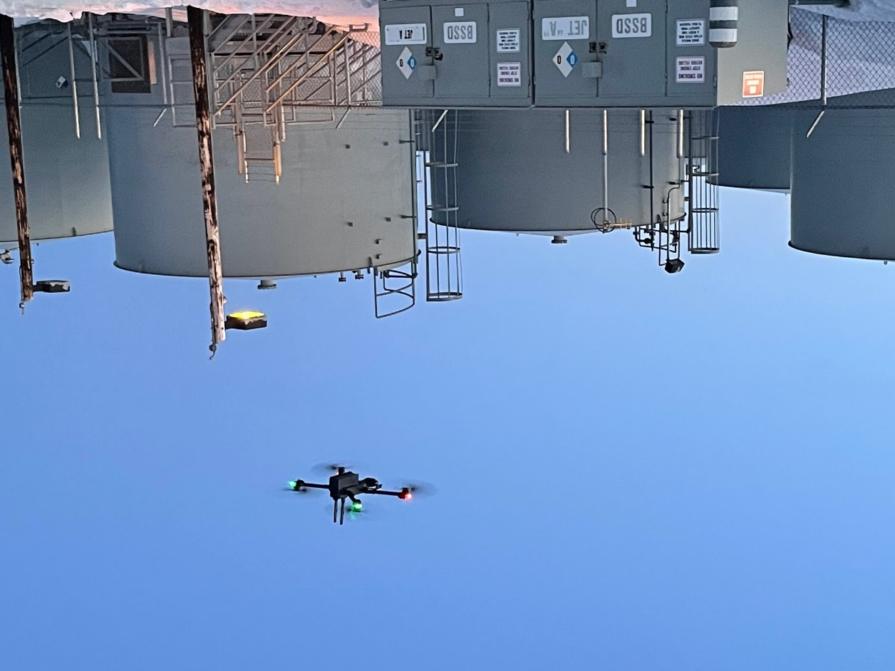
Remote Uncrewed Aircraft System (UAS) Inspection and Response Team Development in the Bering Strait Region: Task 2 - Coproduction of Infrastructure Inspection Operational Protocols
ADAC Program Year 8 Annual Meeting 20-21 April 2022
Determine current tank and fuel delivery infrastructure inspection requirements,
Coproduce a UAS-based tank and fuel delivery infrastructure inspection protocol ,
Perform infrastructure inspection flights and product delivery tests.
Unalakleet tank farm test flight with X2E flown by K. Daniels. Photo c/o J. Garron

Slide 16
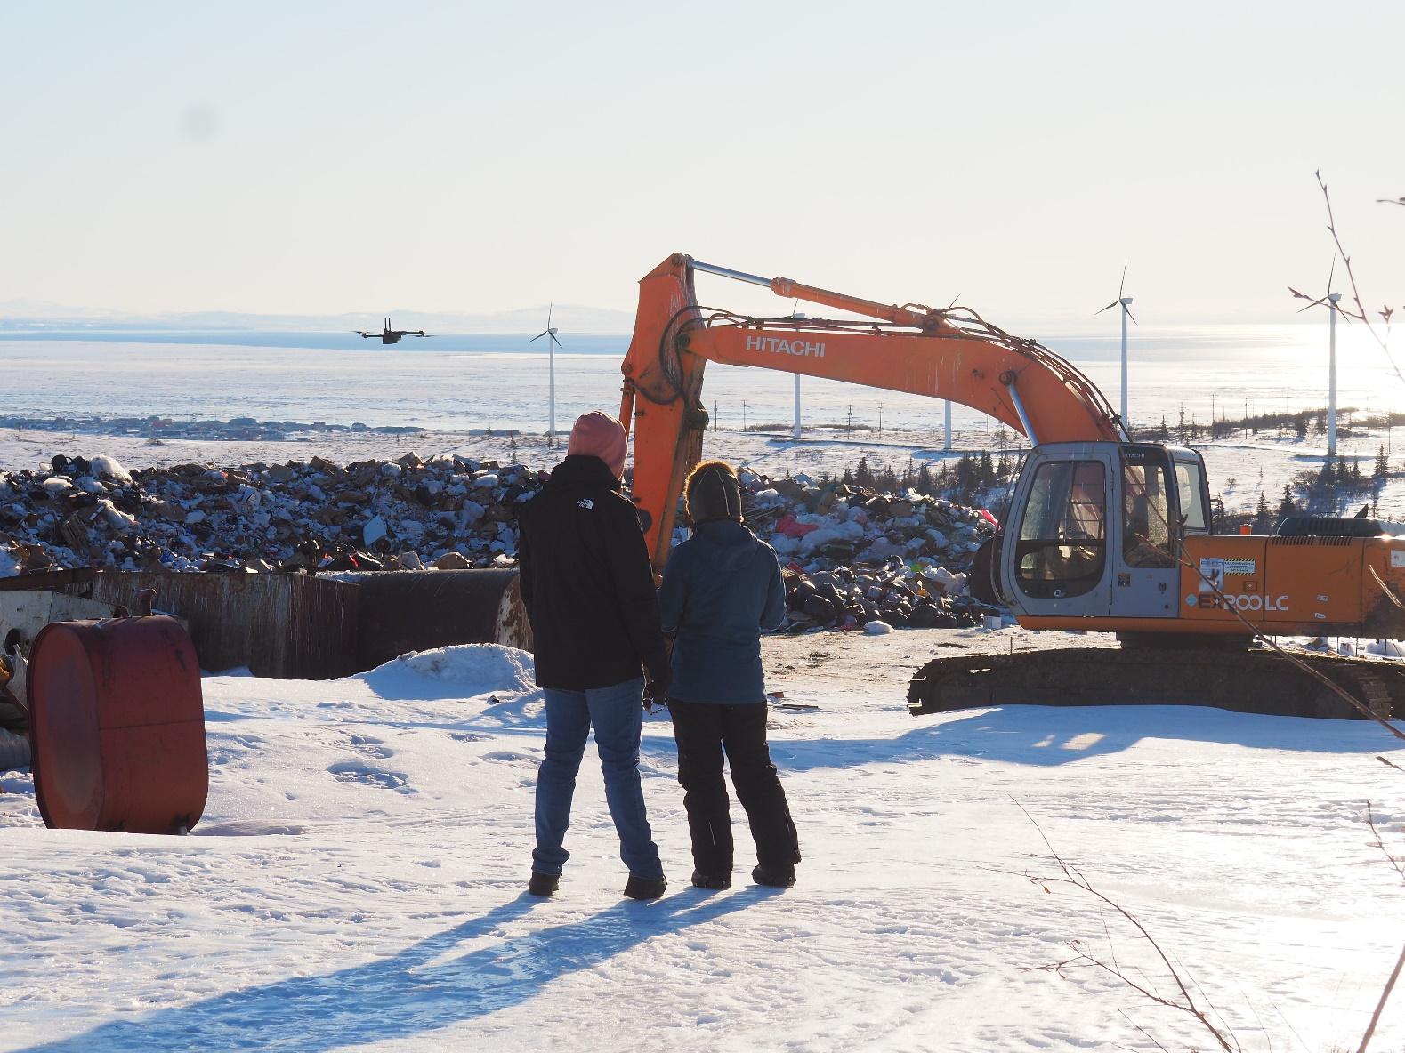
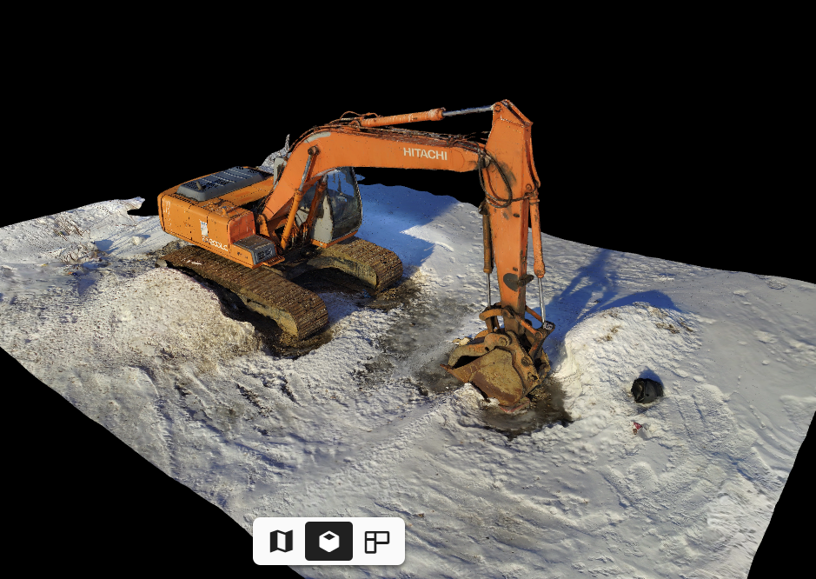
ADAC Program Year 8 Annual Meeting 20-21 April 2022
M. DeLue
NVU UAS pilot K. Daniels and Skydio trainer J. Garcia flying a 3D scan during on-site flight training.

Slide 17
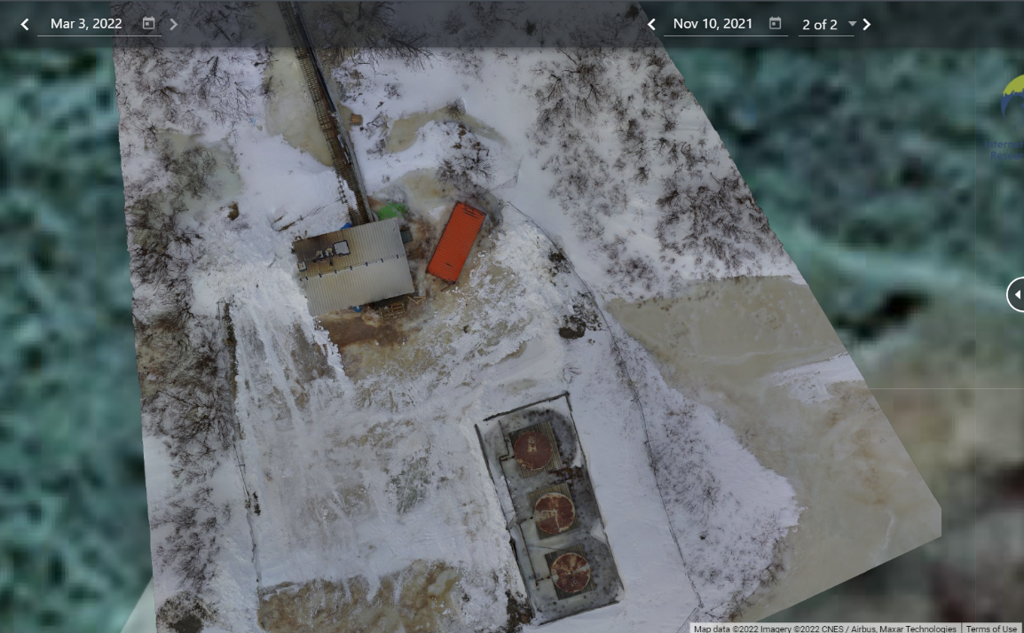
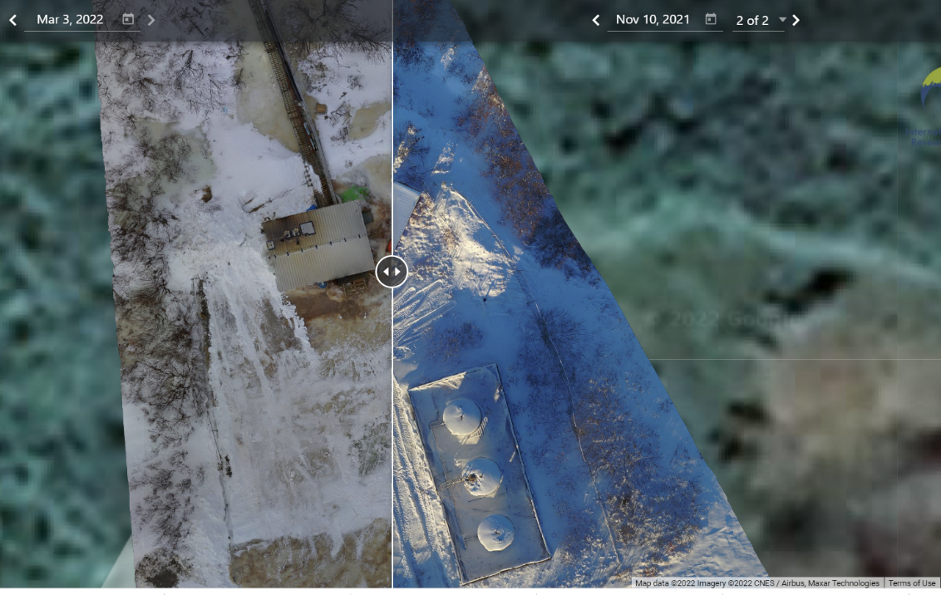
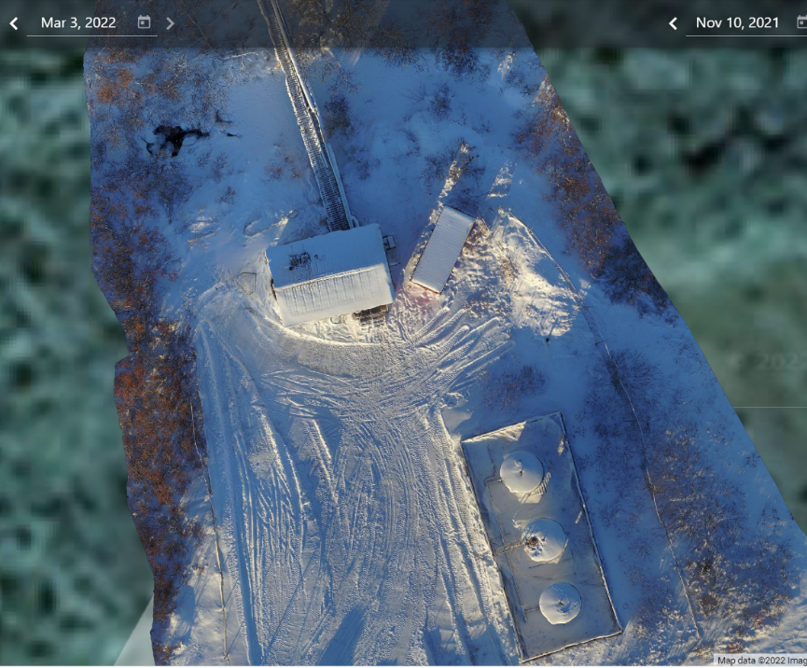
ADAC Program Year 8 Annual Meeting 20-21 April 2022
Remote Uncrewed Aircraft System (UAS) Inspection and Response Team Development in the Bering Strait Region: Task 2 - Coproduction of Infrastructure Inspection Operational Protocols
Sample of simple change detection of 2D map of Unalakleet water supply pump house. Images captured and processed by K. Daniels using DroneDeploy.

Slide 18

Remote Uncrewed Aircraft System (UAS) Inspection and Response Team Development in the Bering Strait Region: Task 3 - Coproduction of Emergency Response Assessment Protocols
ADAC Program Year 8 Annual Meeting 20-21 April 2022
Determine key community assets for monitoring pre/post emergency response,
Coproduce emergency response UAS protocol based upon surveys of key community assets,
Perform emergency response baseline flights and product delivery tests.
Image courtesy of skycoreaviation.com

Slide 19
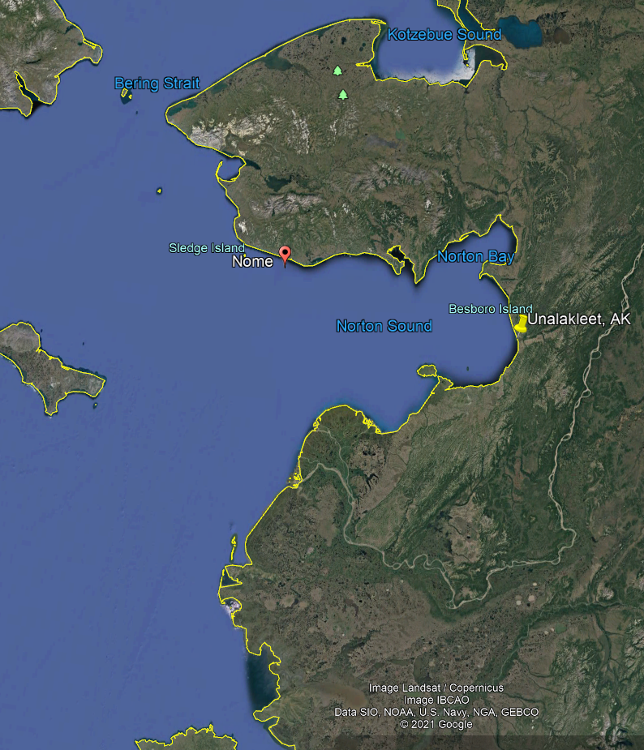
Remote Uncrewed Aircraft System (UAS) Inspection and Response Team Development in the Bering Strait Region: Task 4 – Regional Expansion Feasibility Assessment
ADAC Program Year 8 Annual Meeting 20-21 April 2022
Summarize key (local and regional) documents for critical infrastructure and emergency response information,
Develop regional contact list and conduct regional UAS survey,
Finalize assessment.

Slide 20
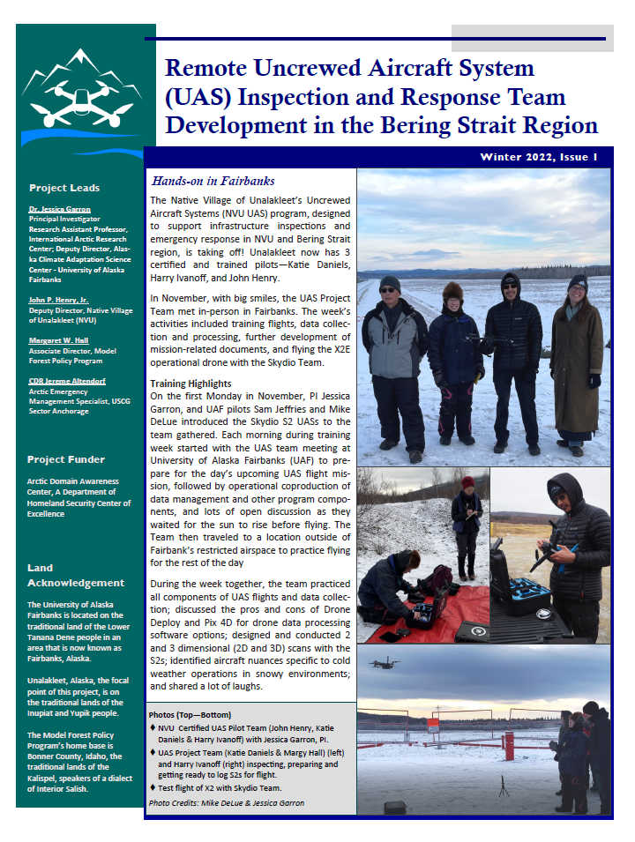
Remote Uncrewed Aircraft System (UAS) Inspection and Response Team Development in the Bering Strait Region: Task 5 - Knowledge Product Development & Information Dissemination Products & Publications
ADAC Program Year 8 Annual Meeting 20-21 April 2022
Create USCG-focused Knowledge Product,
Engage non-technical stakeholders (locally, regionally, nationally) (on-going),
  FB page for pilot blogging and Q&A
  All recordings from YouTube
  Quarterly Newsletters
  Interviews – Radio, TV, Press Releases
Develop and submit publication to peer reviewed journal.

Slide 21
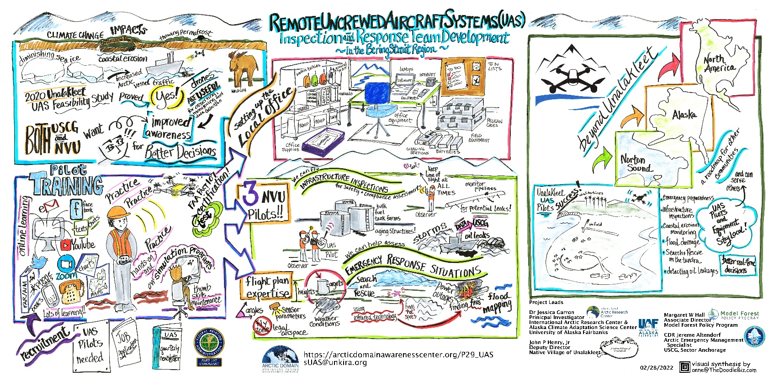
Remote Uncrewed Aircraft System (UAS) Inspection and Response Team Development in the Bering Strait Region: Task 5 - Knowledge Product Development & Information Dissemination Presentations
  ADAC YR7 presentations
  UNK Search and Rescue
  Innovations in Climate Resilience (Battelle)
  UNK City Council
  Alaska Forum on the Environment
  Alaska Tribal Resilience Learning Network
  International Circumpolar Remote Sensing Symposium

Slide 22

ADAC Program Year 8 Annual Meeting 20-21 April 2022
Beyond Unalakleet...
Regional Expansion Feasibility Analysis in Support of Transition Planning
Investigate long-term & regional implementation strategies.
Identify, assess, and prioritize critical infrastructure, vulnerable community assets, and emergency response scenarios for UAS support.
Outreach to local, regional and federal entities (e.g. IGAP coordinators, public works staff, emergency responders and communications technicians) for critical input.
Develop NVU UAS contracting mechanisms.
Integrate key findings into USCG Knowledge Product.
Report findings.
Photo c/o M. DeLue

Slide 23

Remote Uncrewed Aircraft System (UAS) Inspection and Response Team Development in the Bering Strait Region: Research Outcomes
ADAC Program Year 8 Annual Meeting 20-21 April 2022
A knowledge product for the USCG as a use case for other areas/applications
A developed set of SOPs and operational UAS protocols for,
  Infrastructure Inspection
  Oil Spill Detection
  Flood Delineation
  Search and Rescue Support
Establishment of a Norton Sound/Bering Strait regional UAS team for USCG mission support
Bering Strait regional feasibility assessment for UAS program implementation
Photo c/o J. Garron

Slide 24
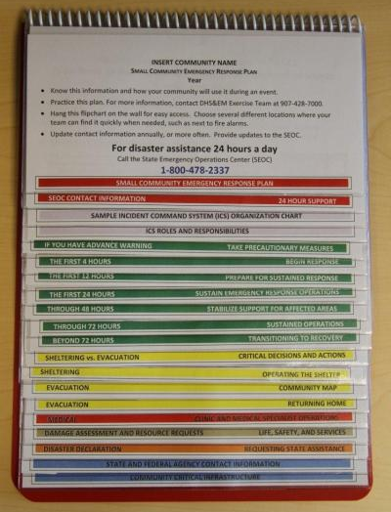
Impacts and Applications
UAS enhanced support of...
FEMA Hazard Mitigation Plans
State of Alaska DHS&EM Small Community Emergency Response Plans (SCERP)
Local infrastructure monitoring capacity and fund acquisition
USCG regional inspection support
USCG regional emergency response
Arctic security - surveillance
State of Alaska DOT asset integrity - Runways, roads, bridges
Bering Strait regional energy planning processes
Bering Strait economic development plans
Sample SCERP

Slide 25
Remote Uncrewed Aircraft System (UAS) Inspection and Response Team Development in the Bering Strait Region
Dr. Jessica Garron
jigarron@alaska.edu
Thank You
Notes:
Thank you for the gift of your time and attention.

